Slide 1
Project 1

Slide 2
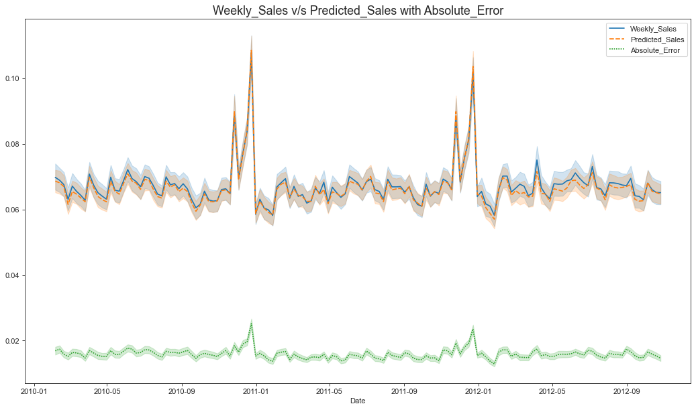
Sale Forcasting & Anomaly Detection on Walmart Dataset
Under the supervision of
Dr. Soumitra Samanta
Department of Computer Science
RKMVERI, Belur

Slide 3
Introduction
What is forecasting ?
A technique that takes historical data as inputs to estimate the future values or trends.
What is anomaly inside a data?
Data points, events or observations that deviate from a datasets normal behaviour.
Why is it important?
An online retail business must predict which discounts, events or new products, may trigger boosts in sales which will increase demand on their web servers.
IT security team must prevent hacking and needs to detect abnormal login patterns and user behaviors.
Identifying abnormal Heartbeats ECG graphs

Slide 4
Motivation
The reason to select time dependent data is, they are one of the most occurring real world data. Again in real life situation most of the datas are not labeled as anomaly or non-anomaly . So considering the real life situation I choose the dataset.
The Main Objective of forecasting is to predict sales of store in a week.
The objective of Unsupervised Anomaly Detection is to detect previously unseen rare objects or events without any prior knowledge.

Slide 5
A bit about the data set
An American multinational retail corporation that operates a chain of hypermarkets, discount department stores, and grocery stores from the United States.
I took ‘Walmart’ dataset from data.world.
It contains historical sales data for 45 Walmart stores located in different regions.
Each store contains a number of departments (uniquely 81)

Slide 6
Forecasting
In the first phase I do some data manupulations and do some feature engineering. After the data set has been ready I have implemented some machine learning algorithms.
I have started with random forest regressor and get the accuracy near about 76%.
Then I have implemented more treditional Machine Learning Regression techniques.
Their accuracies as follows:

Slide 7
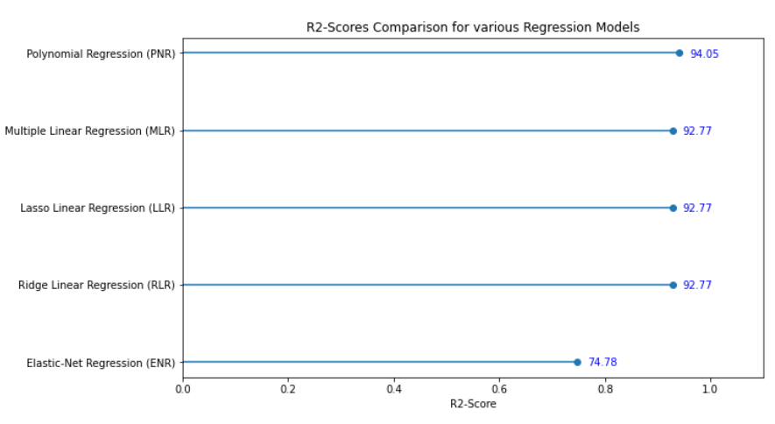
R2 score of Several Regressors:

Slide 8
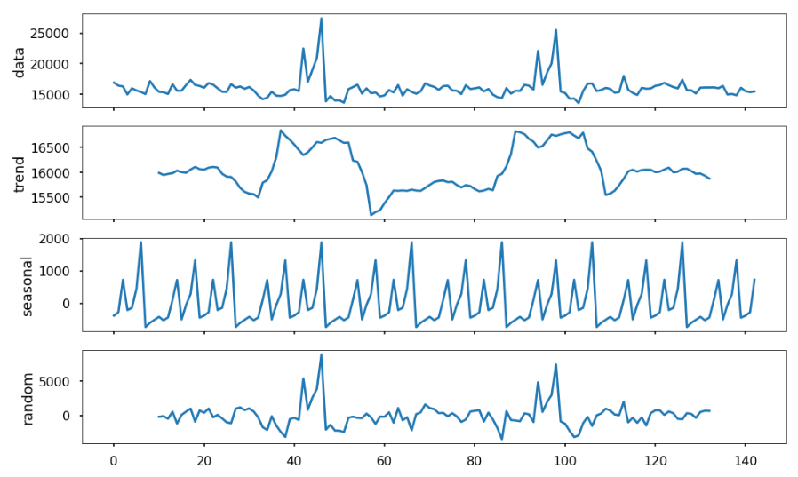
Time Series Forecasting of the data:
First I have done a time series decomposition of the average sale of the dataset to see its various components.
Then I make it stationary
by differencing methods.
Finally fitted the data into an
ARIMA model.
The best model turns out
ARIMA(3,0,2).

Slide 9
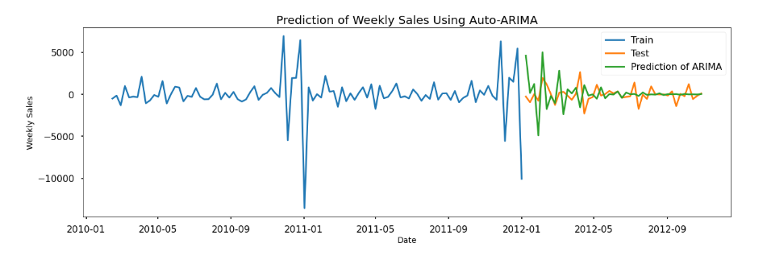
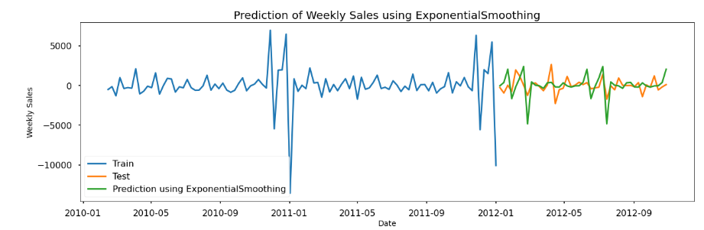
Time Series Forecasting Results:

Slide 10
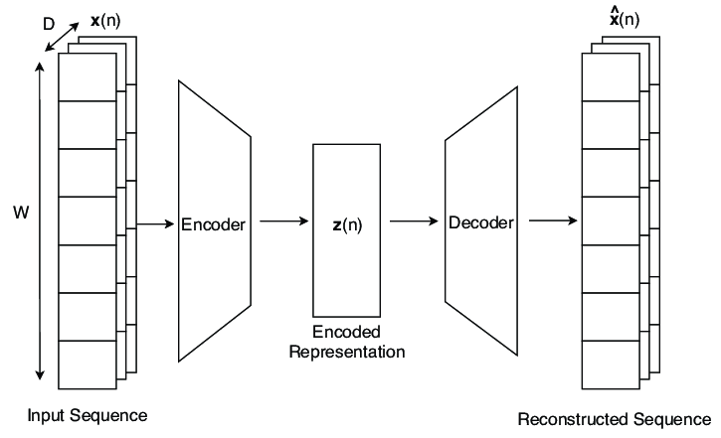
Anomaly Detection:
Algorithms I have implemented to detect anomalies:
KNN Regressor
DBSCAN
LSTM with Auto-Encoders
Finally Model which I have selected:
LSTM with Auto-Encoders
Source

Slide 11
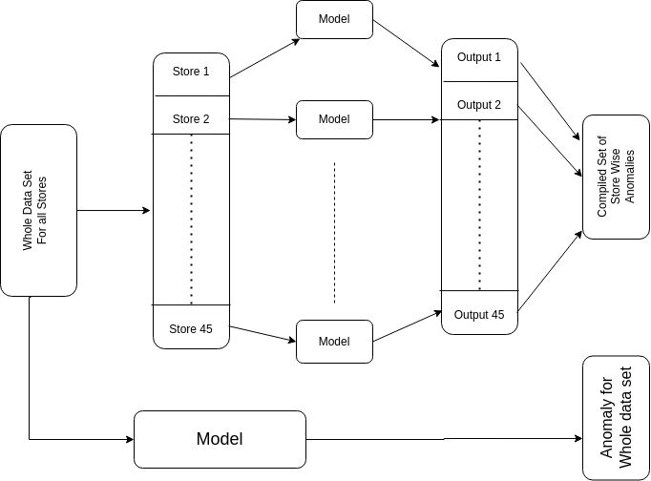
Outline

Slide 12
Algorithms we’ve used to detect the anomalies
DBSCAN
KNN Regressor
LSTM

Slide 13
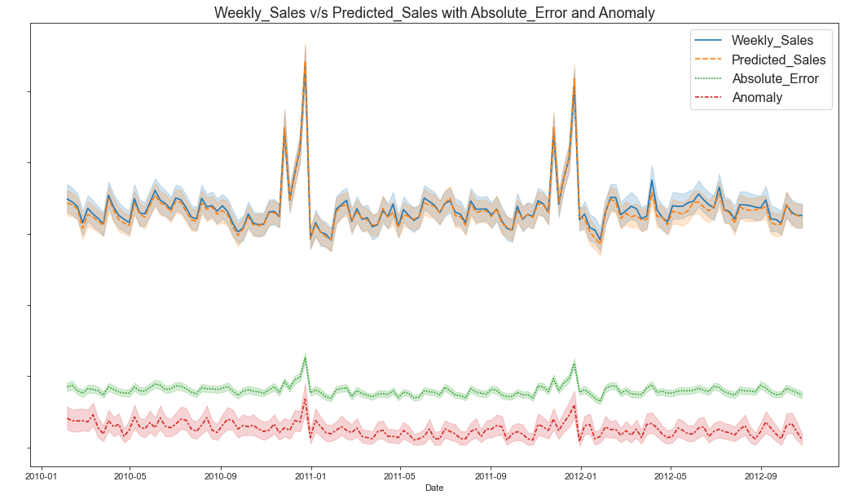
KNN Regressor
Though KNN Regressor predicting the sales with a good accuracy but the threshold methods we are using to detect the anomalies is giving us some error.

Slide 14
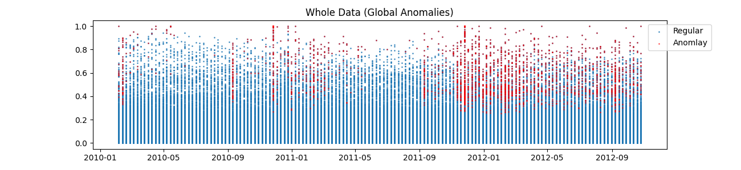

DBSCAN
Depends on epsilon (radius of hypersphere) and minimum samples.
Based on these parameters, the algorithm determines whether certain values in the dataset are outliers or not.

Slide 15
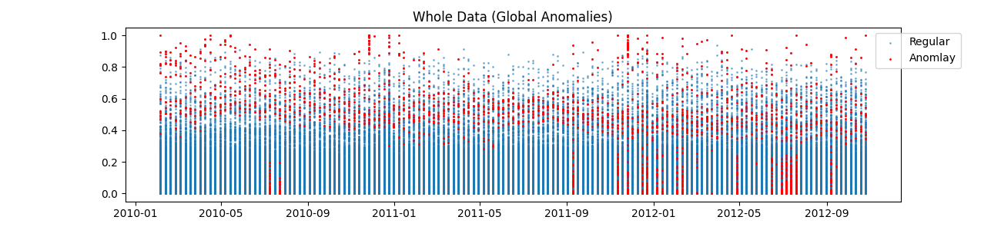
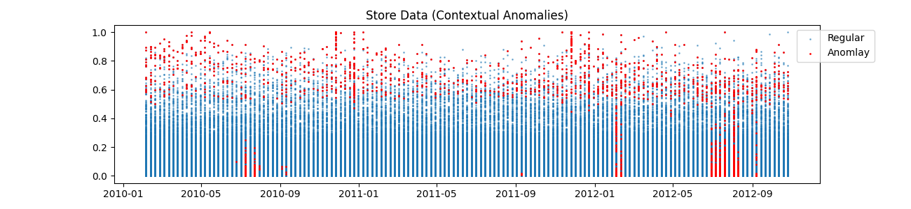
LSTM AutoEncoder
Unlike ARIMA or Prophet, this does not rely on specific assumptions about the data such as time series stationarity or the existence of a Date field.

Slide 16
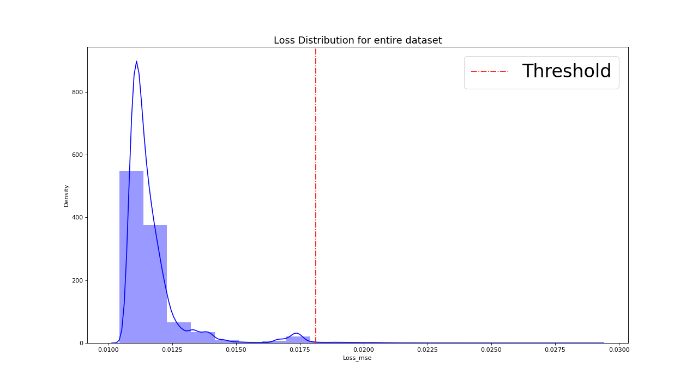
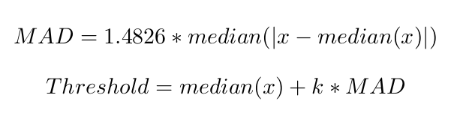
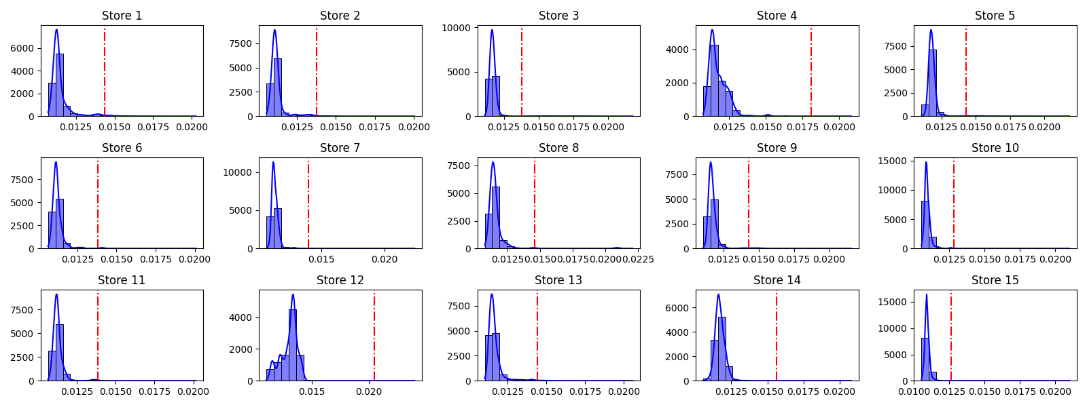
Threshold
Where, k is a constant, we took k = 13
MAD (Median absolute deviation) is a robust measure for detecting anomalies

Slide 17
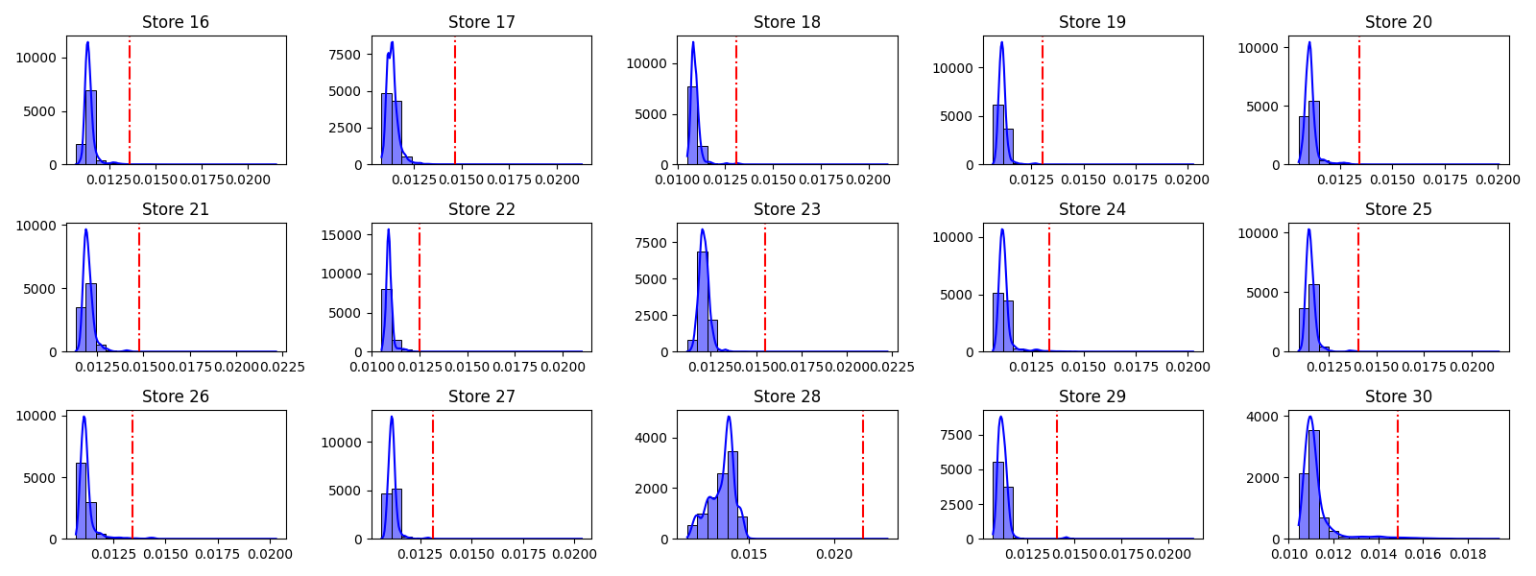
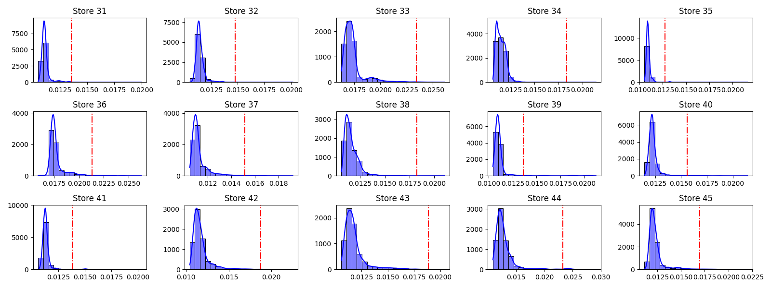

Slide 18
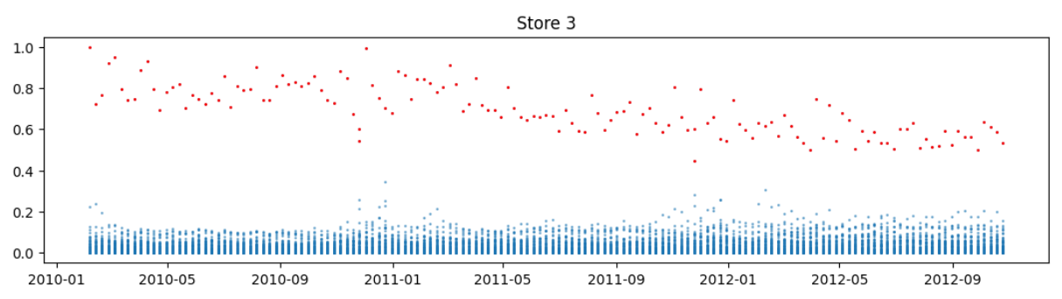
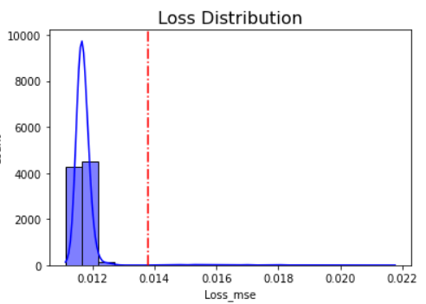
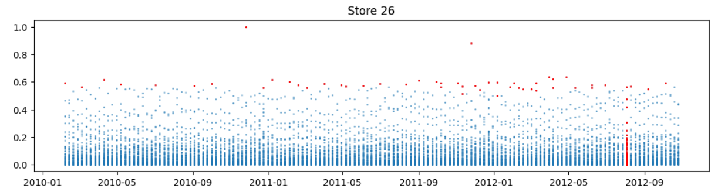
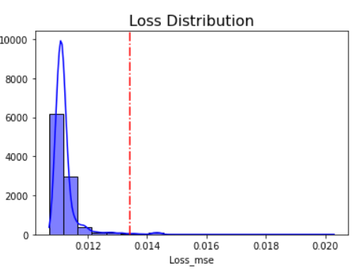

Slide 19
Comparison
Model | Store Wise | Whole Data
DBSCAN | 2257 (0.54%) | 2263 (0.54%)
LSTM | 2239 (0.53%) | 2365 (0.56%)

Slide 20
Reference
Pasi Fr¨anti Jiawei Yang, Susanto Rahardja.Outlier detection: how to threshold outlier scores?
(https://www.researchgate.net/publication/337883760_Outlier_detection_how_to_threshold_outlier_scores, 2016)
Gloria Wang Benjamin Smith, Kevin Cant. Anomaly detection with sdae. (https://arxiv.org/pdf/2004.04391.pdf, 2016)
Ihssan Tinawi. Machine learning for time series anomaly detection.
(https://hdl.handle.net/1721.1/123129, 2016.)
End of Project 1

Slide 21
Project 2

Slide 22
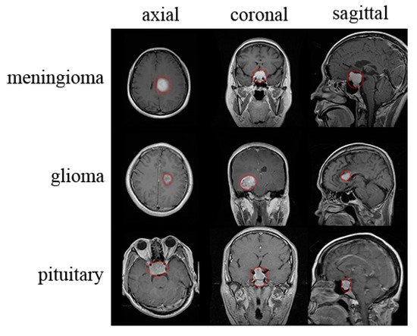
Brain Tumour Classification
Under the supervision of
Mrinmay Maharaj
Department of Computer Science
RKMVERI, Belur

Slide 23
Introduction
Radiology is a broad subject that needs more knowledge and understanding of medical science to identify tumors accurately. The need for a tumor detection program, thus, overcomes the lack of qualified radiologists. Using magnetic resonance imaging, biomedical image processing makes it easier to detect and locate brain tumors.
In this Project, a segmentation and detection method for brain tumors was developed using images from the MRI sequence as an input image to identify the tumor area. This process is difficult due to the wide variety of tumor tissues in the presence of different patients, and, in most cases, the similarity within normal tissues makes the task difficult. The main goal is to classify the brain in the presence of a brain tumor or a healthy brain.

Slide 24
Data Source and Description:
This dataset is a combination of the following three datasets available in kaggle:
figshare
SARTAJ dataset
Br35H
This dataset contains 7022 images of human brain MRI images which are classified into 4 classes: glioma - meningioma - no tumor and pituitary.
“No tumor” class images were taken from the Br35H dataset.

Slide 25
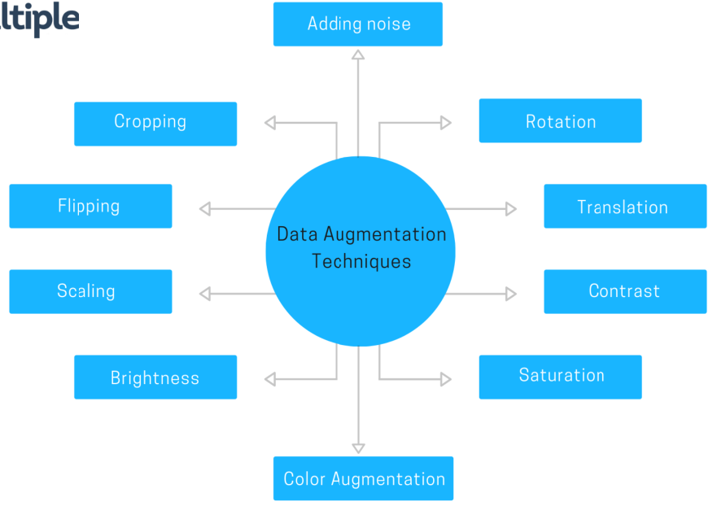
Data Augmentation:
Data augmentation is useful to improve performance and outcomes of machine learning models by forming new and different examples to train datasets. If the dataset in a machine learning model is rich and sufficient, the model performs better and more accurately.
I am using Vertical flip, Horizontal flip and some basic filter like colorJitter and some Sharpness enhancement for the augmentations.
Source

Slide 26
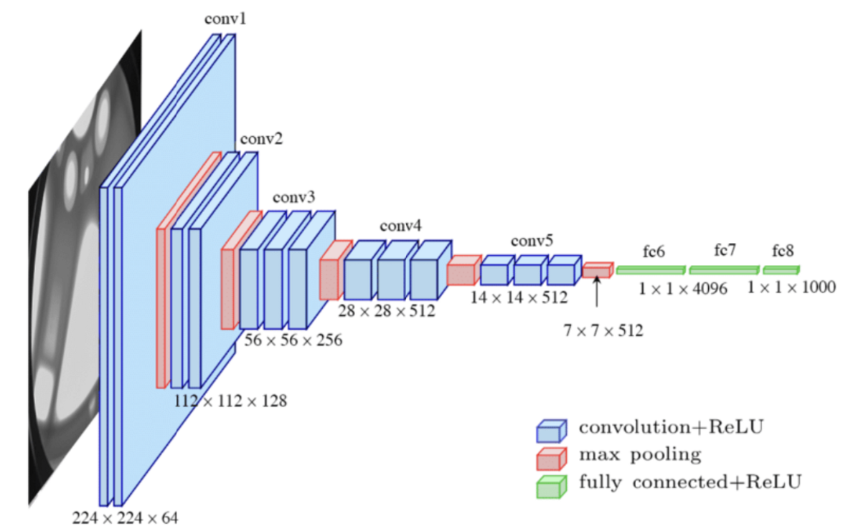
Baseline Model:
I have started with pretrained VGG16 model and implemented transfer learning techniques to update the weights of the model according to our data.
The VGG-16 architecture is able to classify 1000 different labels; we just need 4 instead. In order to do that we are going replace the last fully connected layer of the model with a new one with 4 output features instead of 1000.
Source

Slide 27
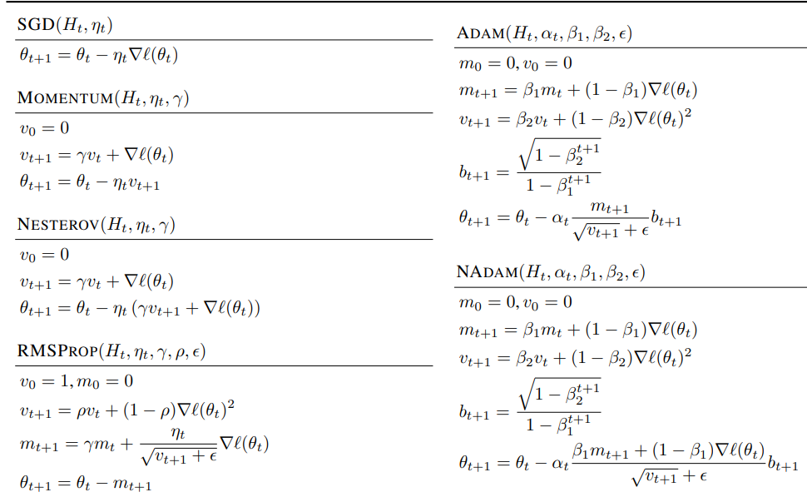
Experimenting with several Optimizers:
It is very important to select a good optimizer for our model during the training process, to make our predictions as correct as possible with a relatively smaller number of epochs.
I have implemented several optimizers and plot their loss and accuracy curves for both train and validation set for different initial learning rates.
Source

Slide 28
Experimenting with several Optimizers:
It is very important to select a good optimizer for our model during the training process, to make our predictions as correct as possible with a relatively smaller number of epochs.
I have implemented several optimizers and plot their loss and accuracy curves for both train and validation set for different initial learning rates.
Source

Slide 29
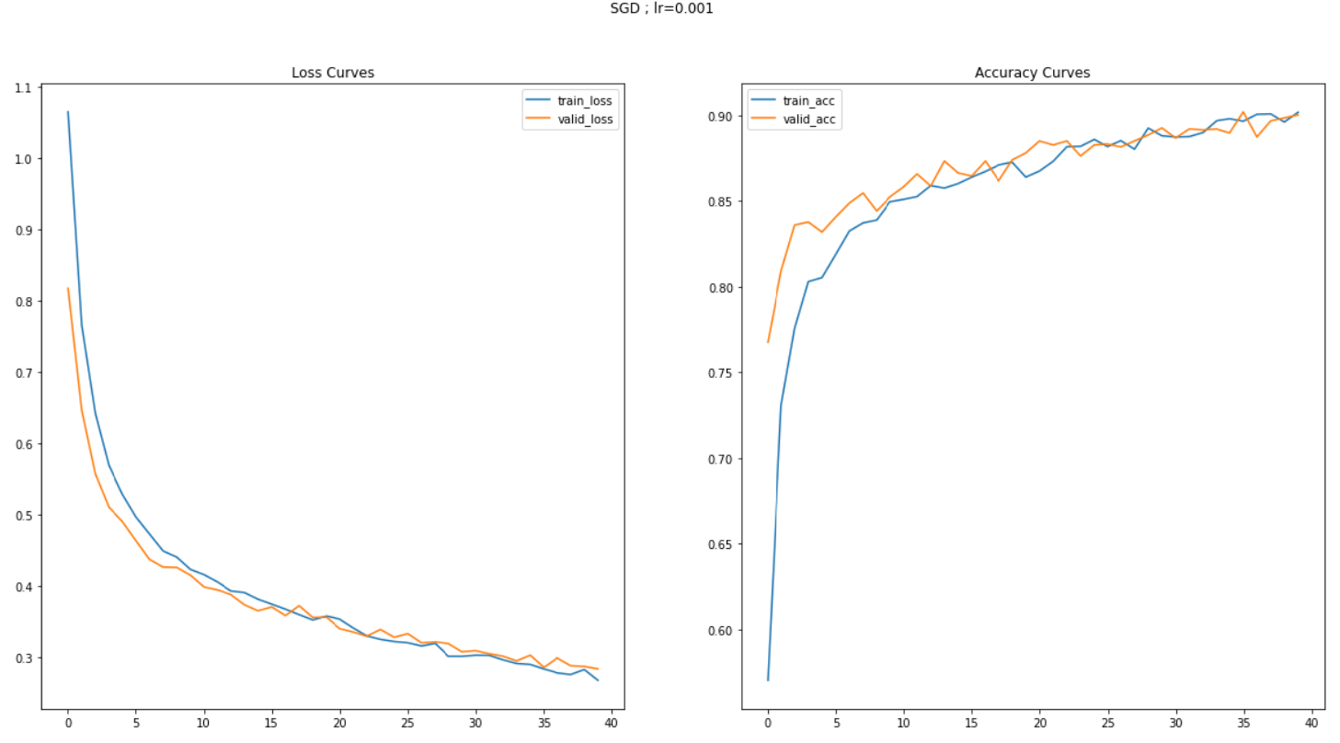
Loss and Accuracy curve for SGD with learning rate 0.001:

Slide 30
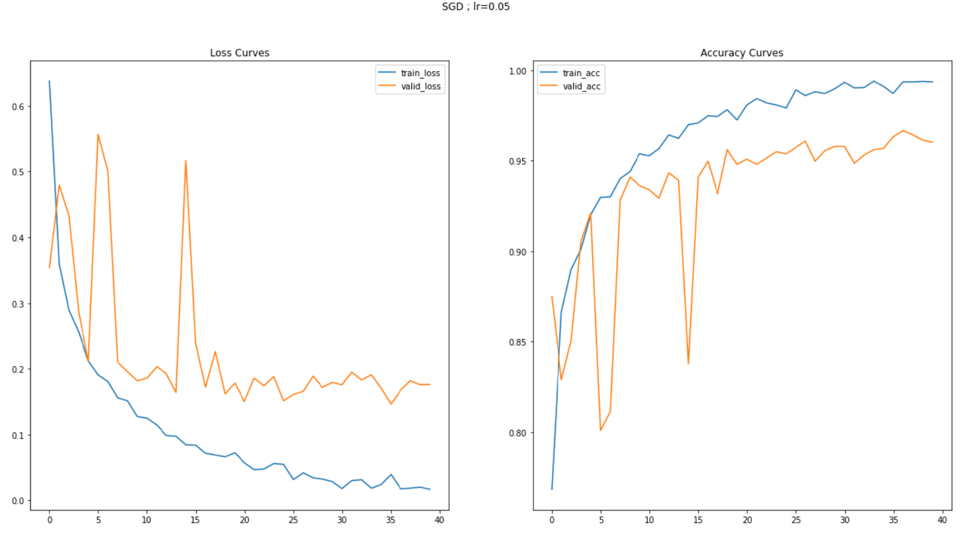
Loss and Accuracy curve for SGD with learning rate 0.05:

Slide 31
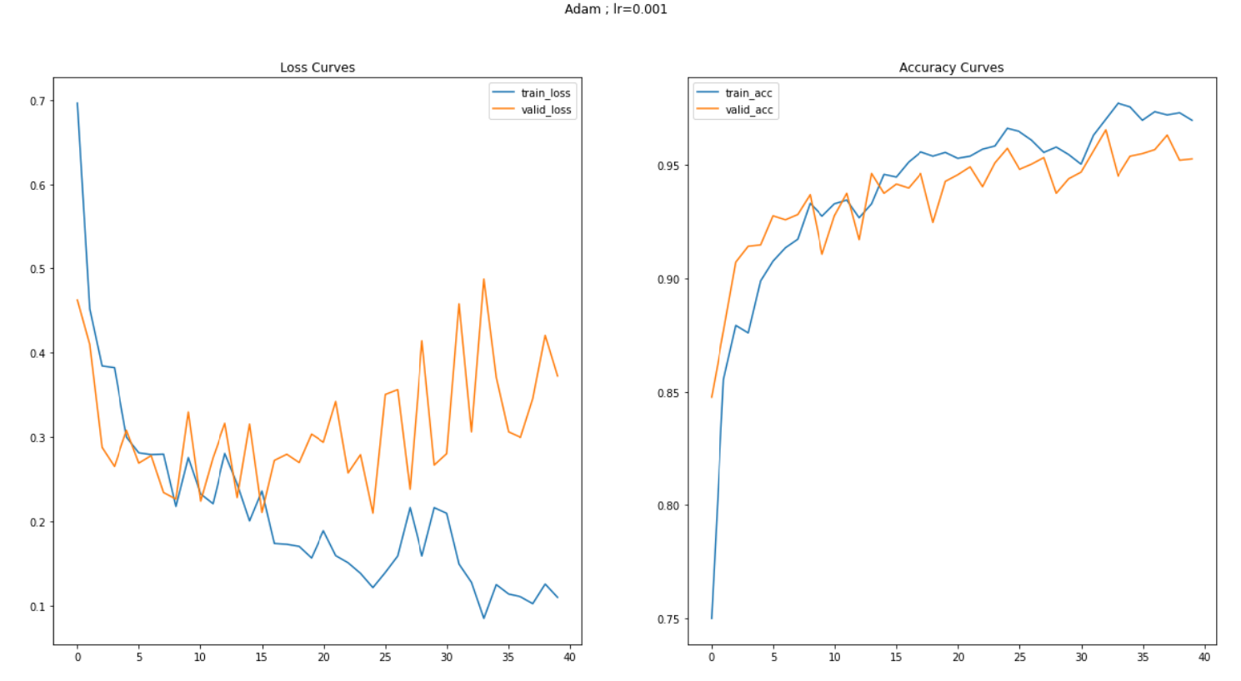
Loss and Accuracy curve for ADAM with learning rate 0.001:

Slide 32
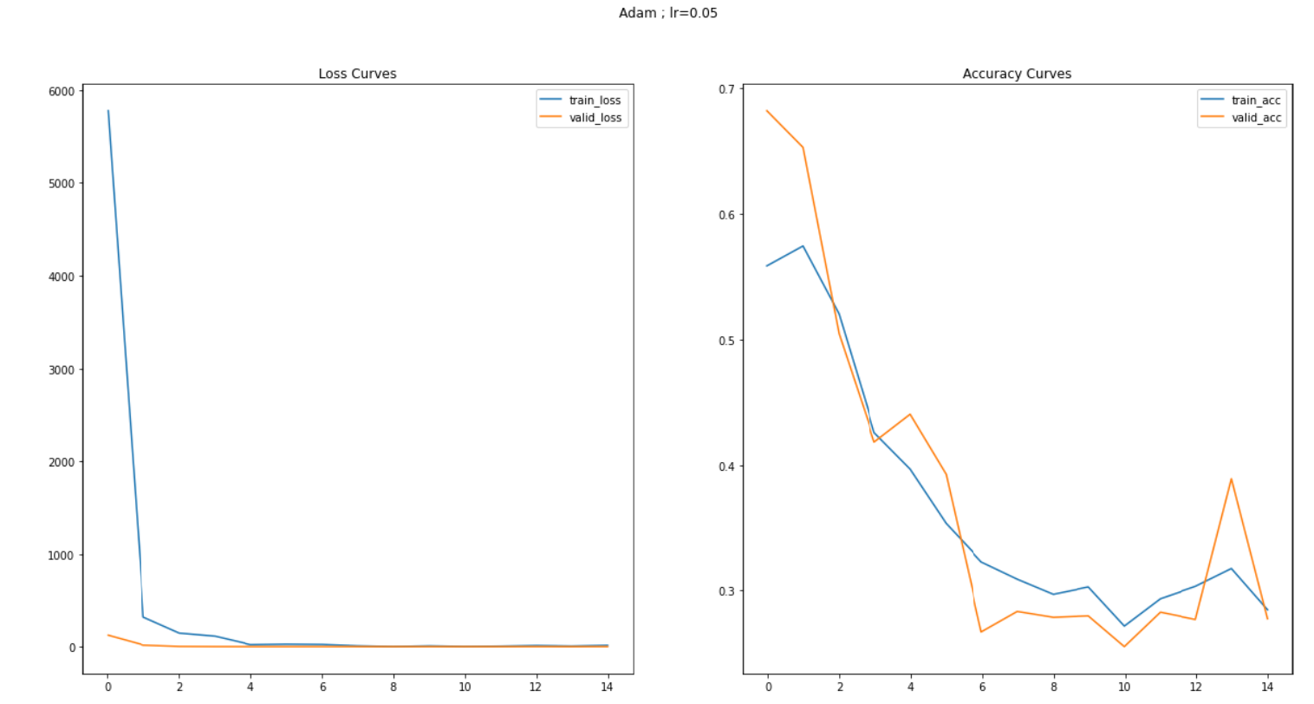
Loss and Accuracy curve for ADAM with learning rate 0.05:

Slide 33
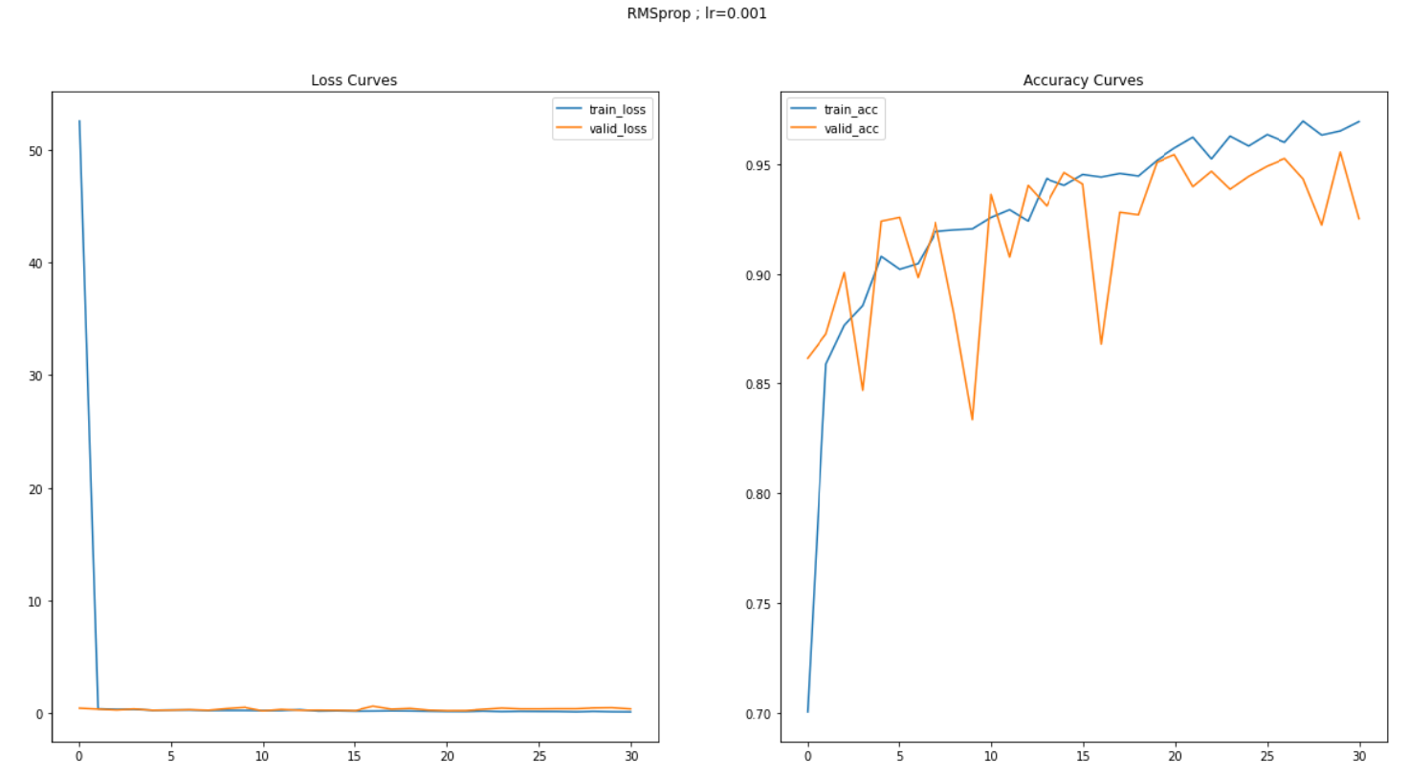
Loss & Accuracy curve for RMSprop with learning rate 0.001:

Slide 34
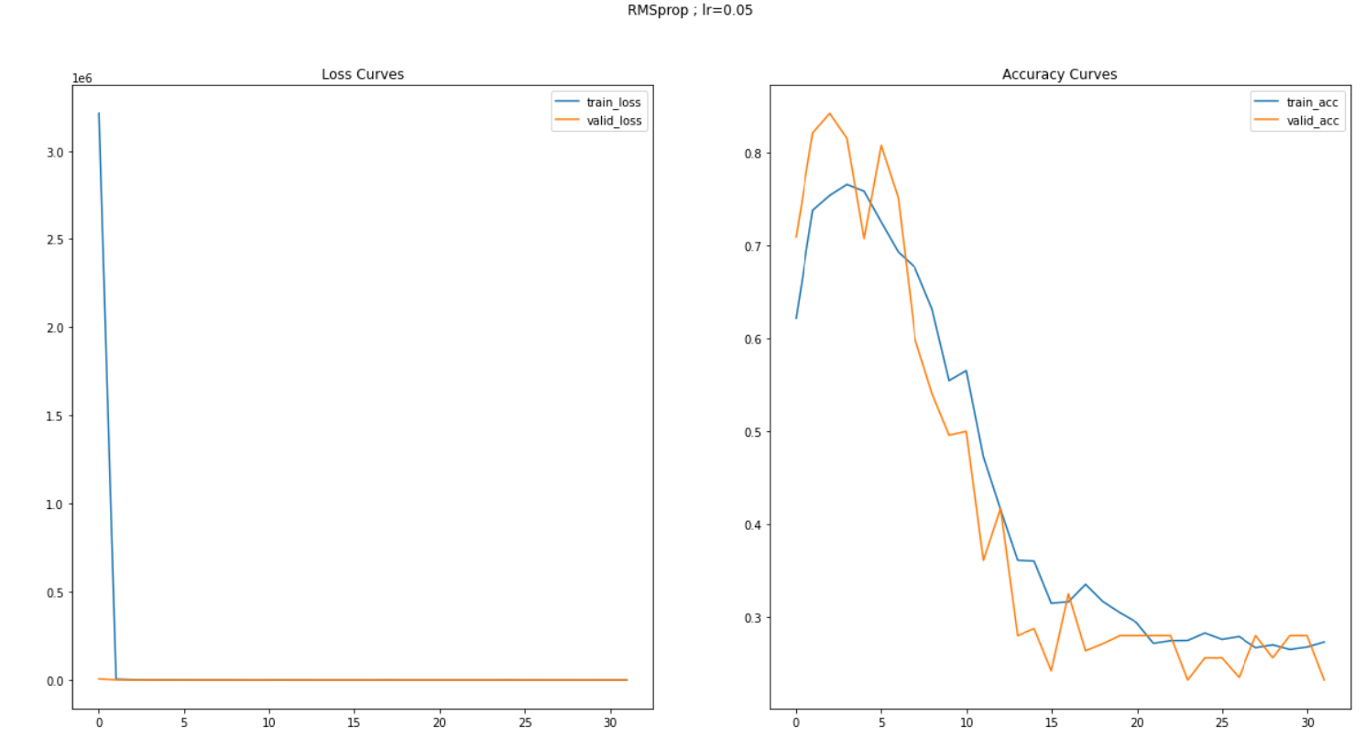
Loss & Accuracy curve for RMSprop with learning rate 0.05:

Slide 35
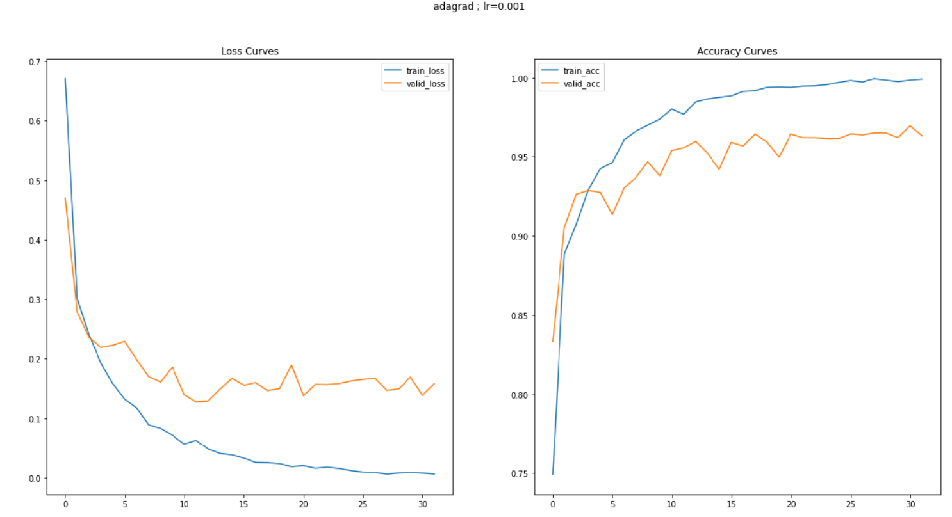
Loss & Accuracy curve for AdaGrad with learning rate 0.001:

Slide 36
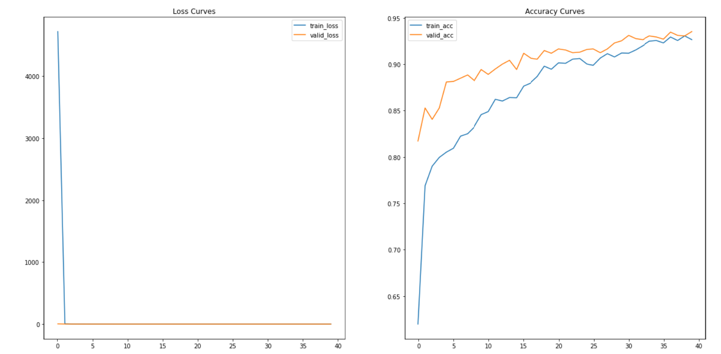
Loss & Accuracy curve for AdaGrad with learning rate 0.05:

Slide 37
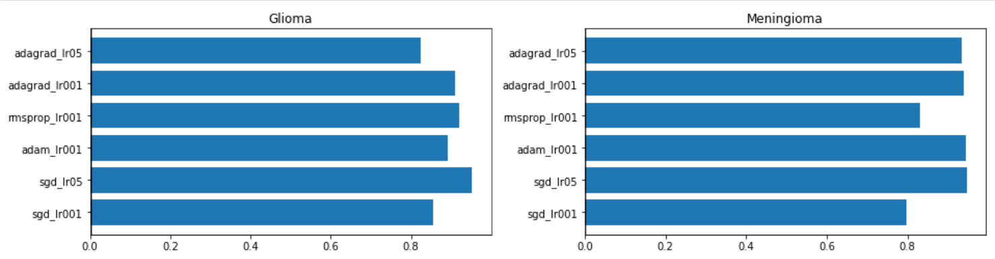
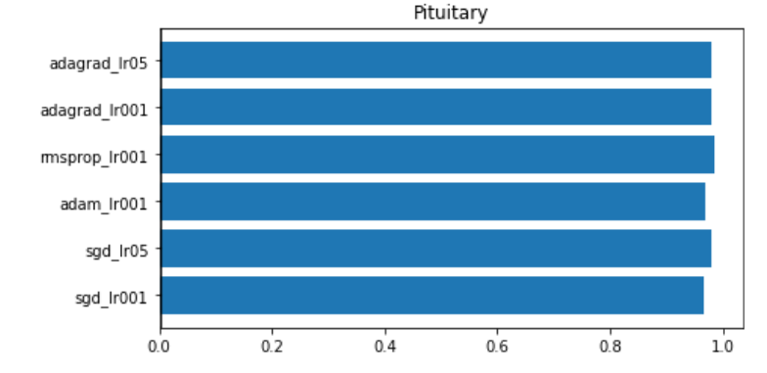
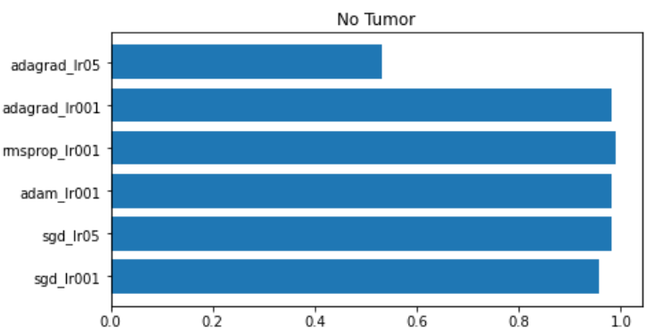
Overall accuracies of different optimizers for different classes:

Slide 38
Observation:
Choosing different optimizer helps to get more accuracy and faster convergence.
Starting with a higher learning rate in RMSprop and ADAM is a bad idea for our dataset as it decreases the accuracy tremendously.
From the graphs we conclude that the most stable optimization algorithms which is giving the highest average accuracy is ADAM with learning rate 0.001.

Slide 39
Creating the final Model:
To increase the accuracy and stability even more I have created a new architecture inspired by VGG-16.
I have applied batch normalization before feeding the values into the activation layer.
The dropout regularization is introduced inside the fully-connected VGG-16 layers.
This time I have used cross entropy as Loss function and ADAM as the optimizer with learning rate 0.001.

Slide 40
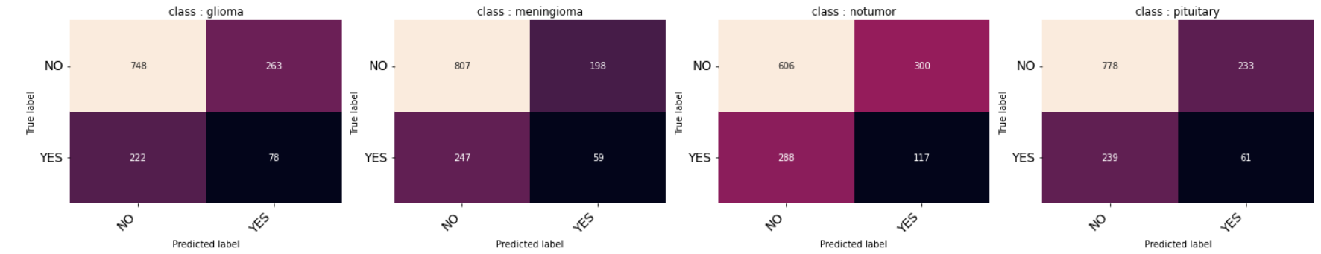
Evalution :
Our Training dataset is limited but it is giving an average of 98.08% percent accuracy after 40 epochs in training dataset and giving an average of 88.19% accuracy for the validation dataset.
For the test data the results have been shown by a confusion matrix:

Slide 41
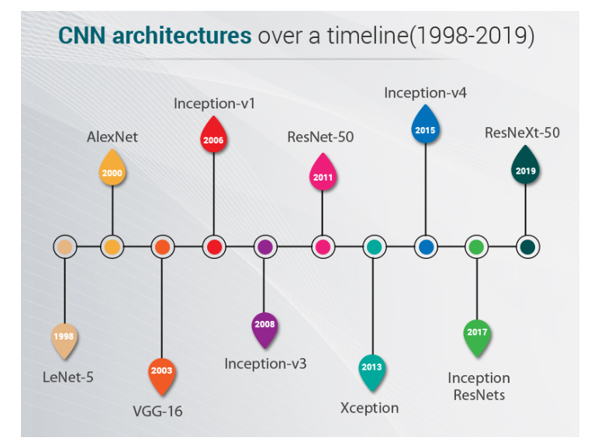
Future Work :
In this particular classification case the model that I have created is giving very good accuracy in spite of having very less amount of training data. In future I shall try to collect more Brain MRI scan data of such patients and again train the model.
Haven’t explore any other ML or DL models other than VGG16. I shall explore more such latest architectures.
Source

Slide 42
Reference :
A Comprehensive Guide on Deep Learning Optimizers.
VGG16-pytorch implementation on CIFAR10 dataset.
Don’t Use Dropout in Convolutional Networks.
A Gentle Introduction to Batch Normalization for Deep Neural Networks
End of Project 2

Slide 43
Project 3

Slide 44
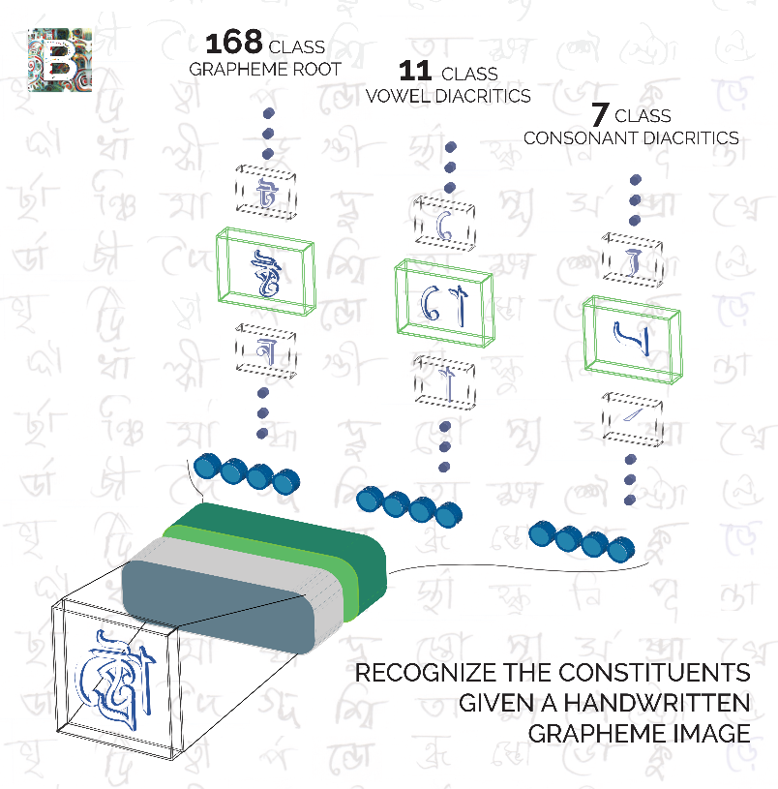
Bengali.AI Handwritten Grapheme Classification
Personal Summer Project
Ujjwal Chowdhury
RKMVERI, Belur
Source

Slide 45
Introduction:
Bengali is the 5th most spoken language in the world with hundreds of million of speakers. It’s the official language of Bangladesh and the second most spoken language in India. Considering its reach, there’s significant business and educational interest in developing AI that can optically recognize images of the language handwritten. This project hopes to improve on approaches to Bengali recognition.

Slide 46
Data Source and Description:
The Dataset is collected from Kaggle. The paper related to this dataset is given is this link.
Main authors of this dataset are Alam, Samiul and Reasat, Tahsin and Sushmit, Asif Shahriyar and Siddique, Sadi Mohammad and Rahman, Fuad and Hasan, Mahady and Humayun, Ahmed Imtiaz.
This dataset contains images of individual hand-written Bengali characters. Bengali characters (graphemes) are written by combining three components: a grapheme_root, vowel_diacritic, and consonant_diacritic. There are roughly 10,000 possible graphemes, of which roughly 1,000 are represented in the training set. The test set includes some graphemes that do not exist in train but has no new grapheme components.

Slide 47
Data Description:
Files:
train.csv
image_id: the foreign key for the parquet files
grapheme_root: the first of the three target classes
vowel_diacritic: the second target class
consonant_diacritic: the third target class
grapheme: the complete character. Provided for informational purposes only, you should not need to use this.
test.csv
Every image in the test set will require three rows of predictions, one for each component. This csv specifies the exact order for you to provide your labels. - row_id: foreign key to the sample submission - image_id: foreign key to the parquet file - component: the required target class for the row (grapheme_root, vowel_diacritic, or consonant_diacritic)

Slide 48
Data Description:
Files:
(train/test).parquet
Each parquet file contains tens of thousands of 137x236 grayscale images. The images have been provided in the parquet format for I/O and space efficiency. Each row in the parquet files contains an image_id column, and the flattened image.
class_map.csv
Maps the class labels to the actual Bengali grapheme components.
Two of the consonant diacritics র্ (class 2) and ্র ( class 5) can coexist in the same grapheme. The original labeling scheme did not account for this possibility so these cases are labeled as class 2.
class_map_corrected.csv is an updated class map that adds this special case as class 7.
I have also used Kalpurush fonts for the traning.

Slide 49
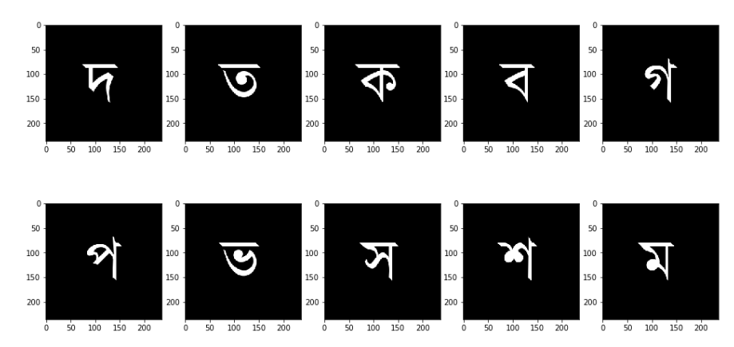
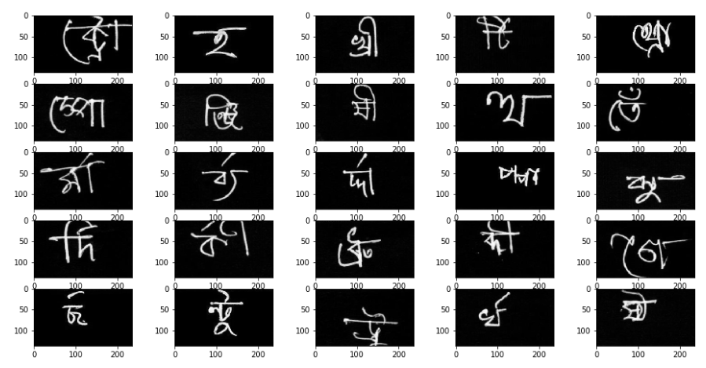
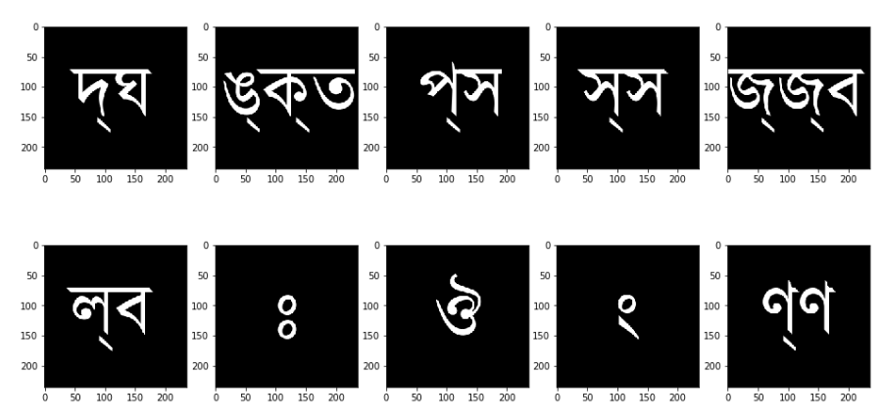
EDA on the Dataset:
A quick summary:
Size of training data: (200840, 5)
Size of class map: (186, 3)
Number of unique grapheme roots: 168
Number of unique vowel diacritic: 11
Number of unique consonant diacritic: 7
Most
Used
Grapheme
Roots
Least
Used
Grapheme
Roots

Slide 50
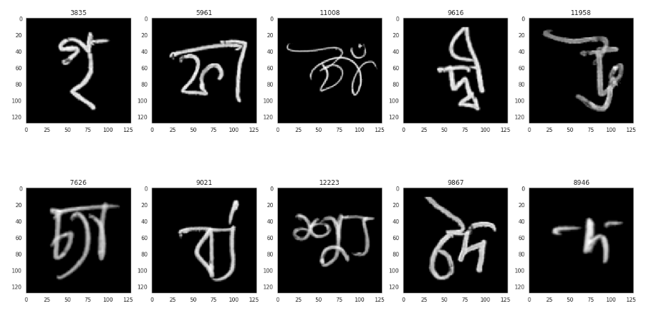
Data Augmentation:
Since the dataset came from 4 different sources. Some of them are grayscale and some of them are colour.
At first I have converted them to gray scale images.
For better understanding I have applied Laplacian filter to increase the sharpness.
Then I have resized the images into 128 x 128 format for training and testing.
Output
After
Augmentation

Slide 51
Model Building:
First I have started with the ResNet50 architecture as my baseline model.
Then I have started modifying my model by adding more CNN layers and using batch normalizations to increase the stability. I have used 3x3 kernels with padding and Relu Activation function inside the CNN layers.
I have added three output nodes after the fully connected dense layers to get the three desired outputs.
The output three nodes are working better with SoftMax activation function.
I have used the ADAM optimizer with categorical cross entropy as loss function.

Slide 52
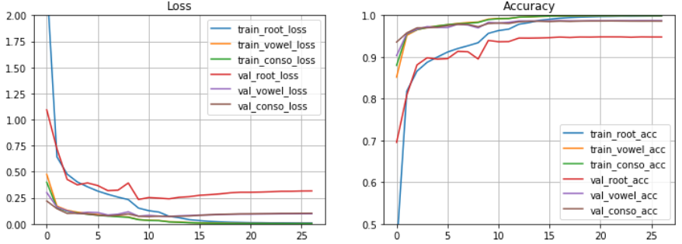
Model Training and Evaluation:
During the training I have used 80% of the data for training and 20% of the data for validation.
Results Below:

Slide 53
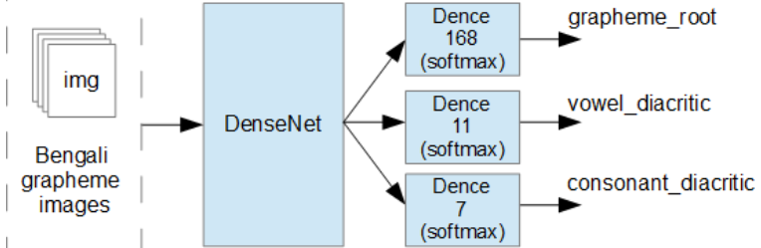
Conclusion:
The Test files inside the dataset does not have any output labels, so I cannot conclude any accuracy for the testing dataset. But more or less the validation split dataset is giving the accuracies as follows:
val_dense_3_accuracy: 0.9512 (Grapheme Root)
val_dense_4_accuracy: 0.9843 (Vowel Diacritic)
val_dense_5_accuracy: 0.9873 (Consonant Diacritic)

Slide 54
Reference:
A Large Multi-Target Dataset of Common Bengali Handwritten Graphemes
Categorical crossentropy
Part I: Bengali.AI Handwritten Grapheme Classification
Part II: Bengali.AI Handwritten Grapheme Classification Model Enchantements
End of Project 3

Slide 55
Thank You
The End

